Slide 1

Principles of Program Design: Problem Solving with JavaScript
Chapter 9
Menus and Data Validation

Slide 2
Objectives
In this chapter, you learn to:
Differentiate between interactive and noninteractive programs
Describe the elements of a menu system
Explain how menus and functions work together
Design a validation loop that minimizes user errors during input

Slide 3
Objectives (cont’d.)
Ensure that valid menu choices are made
Explain the use of data validation methods
Use exception handling in addition to immediate error handling
Design and use multilevel menus

Slide 4
Introduction
Mistakes
  Both programmers and users make them
  Garbage in, garbage out
Design programs to minimize user mistakes
  Identify them so they can be corrected
  Stop program to prevent losing good data
Robust programs
  Handle user errors without damage
  Two methods: menus and data validation

Slide 5
Interactive Versus Noninteractive Programs
Early days of data processing
  Punch cards used for data input
  Verified against paper reports to look for errors
  Input processed as a batch
Today’s environment
  Database
  Immediate transaction processing
    Referred to as interactive processing or real-time processing

Slide 6
Single-Level Menus
Menu system
  Limits user choices
  Only valid options are processed
Example: ask user to select transaction type
  e.g., deposit, withdraw, or balance inquiry
  Single character or digit entered to select menu item
  Accept either uppercase or lowercase characters
    toUpper() function converts input to uppercase

Slide 7
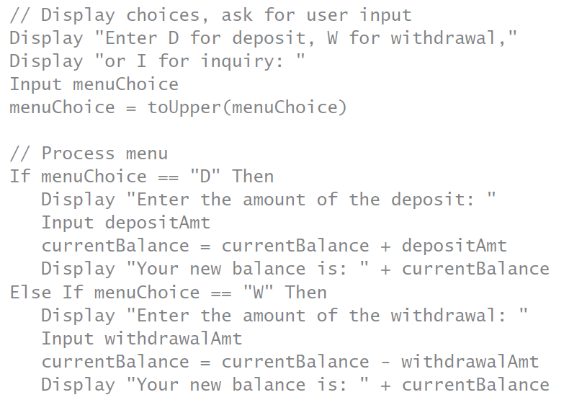
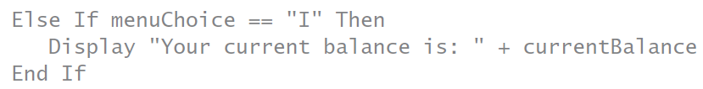

Slide 8
Single-Level Menus (cont’d.)
Example program provides no error message
  If user enters invalid choice
  Program must run again to correct error
Common menu model
  Menu stays on screen for repeated use
    Created using repetition structure enclosing selection structure
    Add option for user to exit menu

Slide 9
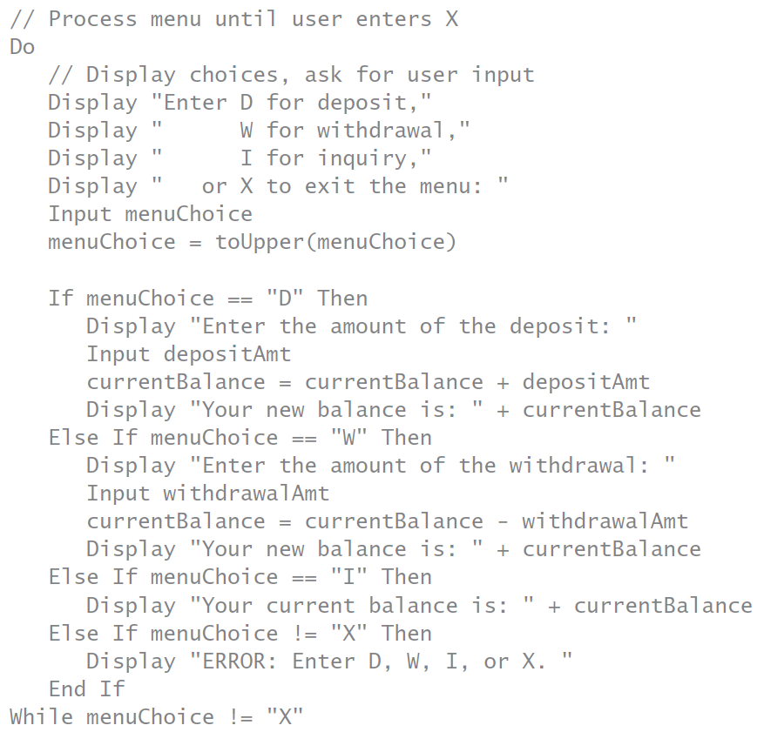

Slide 10
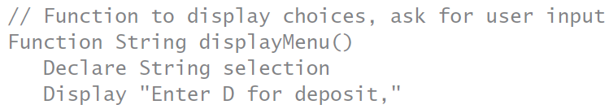
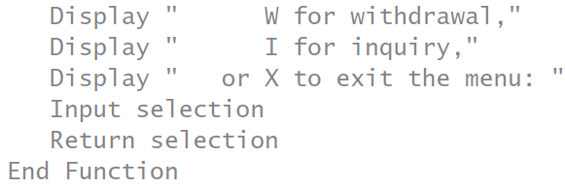
Single-Level Menus (cont’d.)
Menus, functions, and stubs
  Functions can be used to display menu
    And get the user’s choice
  Example function: displayMenu()
    Returns user input value

Slide 11
Single-Level Menus (cont’d.)
Modules can be created for tasks:
  Deposit, withdrawal, and balance inquiry
JavaScript syntax for converting to uppercase
  menuChoice = menuChoice.toUpperCase()
Alert box
  Pop-up box requiring user to click OK
  Syntax: alert(string message)

Slide 12
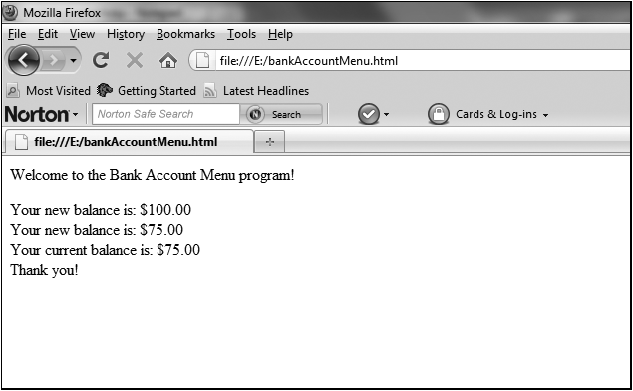
Single-Level Menus (cont’d.)
Complete Program 9-1 on pages 334-337
Figure 9-1 The bankAccountMenu.html program in a Web browser

Slide 13
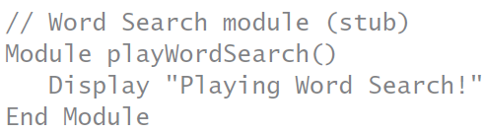
Single-Level Menus (cont’d.)
Module sometimes called a black box
  Meaning one doesn’t need to know internal contents
  Just module’s purpose and how to use it
Stub
  Temporary module for testing purposes
  Serves as program placeholder
    Until code is developed

Slide 14
Single-Level Menus (cont’d.)
Validation loops
  Program check to determine data acceptability
  User prompted to enter acceptable value
  Loop used to ensure acceptable value before proceeding

Slide 15
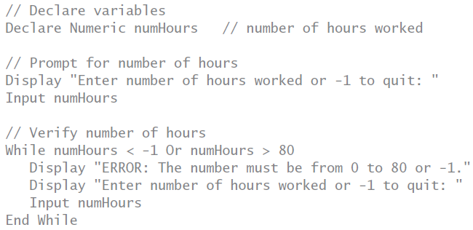
Single-Level Menus (cont’d.)
Example: employees limited to 80 hours per week

Slide 16
Single-Level Menus (cont’d.)
Progressive error messages
  Count number of incorrect entries
  Alert user with more severe messages
Code to verify entry correctness
  Candidate for a module or function
  Example: isValidStatusCode()
    Returns True if code is valid and False if not

Slide 17
Types of Data Validation
Types of checks
  Value in acceptable range
  Value matches specific acceptable values
  Data type
  Presence of data
  Logical relationships of data

Slide 18
Types of Data Validation (cont’d.)
String manipulation functions
  isNumeric(str)
    Returns True if text can be converted to a number
  isLetter(str)
    Returns True if text can be converted to a number
  isNaN()
    Returns True if value can’t be converted to a number
Testing data before converting
  Important to prevent data error crashes

Slide 19
Types of Data Validation (cont’d.)
Data conversion functions
  stringToNumber(str)
    Converts string to numeric value
    parseInt() in JavaScript
  numberToString(num)
    Converts number to a string value
    parseFloat() in JavaScript

Slide 20
Types of Data Validation (cont’d.)
String manipulation functions
  length(str)
    Returns the number of characters in a string
    str.length in JavaScript
  substring(str, start, numChars)
    Returns a substring of the original string
    start specifies starting position
    First position in a string is considered position 0
    str.substr(start, numChars) in JavaScript

Slide 21
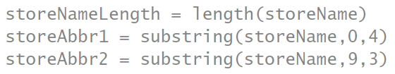
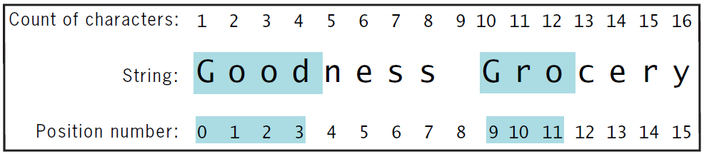
Example: string storeName has been set to value “Goodness Grocery”
After statements performed
  storeNameLength has value 16
  storeAbbr1 has value “Good”
  storeAbbr2 has value “Gro”
Figure 9-2 The length() and substring() functions applied to a string

Slide 22
Types of Data Validation (cont’d.)
Traversing
  Checking every character in a string
Can use relational operators
  Check whether character is in certain range
  Alphabetic letters are consecutive
    In ASCII and Unicode character sets
Check for presence of data
  Can set default value to empty string
    So that field contains data if user doesn’t enter value

Slide 23
Types of Data Validation (cont’d.)
Validate logical relationships between data
  Examples:
    Day of month not less than 1 or greater than number of days in the month
    Five digit zip not included if country code is not US
    Loan out date not later than due date
    Check for valid date format
    Look for characters in certain positions

Slide 24
Types of Data Validation (cont’d.)
Exception handling
  Process of handling data input errors
  Programmer writes code
    Runs when particular exception type detected
    Code put in a Catch block
  Try block contains statements to cause error
    Test whether Catch block works
  When error detected
    Signal created: called “throwing” an exception
    Code in Catch block runs

Slide 25
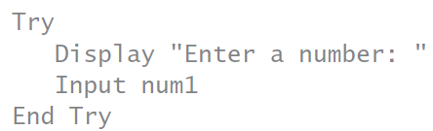
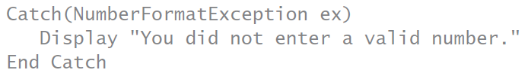
Types of Data Validation (cont’d.)
Example: exception handling

Slide 26
Types of Data Validation (cont’d.)
Try/Catch block combination
  Can be located in module where exception occurred
    If not, exception passed to calling program
    Can be passed multiple times
  If no Try/Catch block in main module:
    Exception passed to operating system
    Crash occurs
  Example on next slide: module checks for two exception types

Slide 27
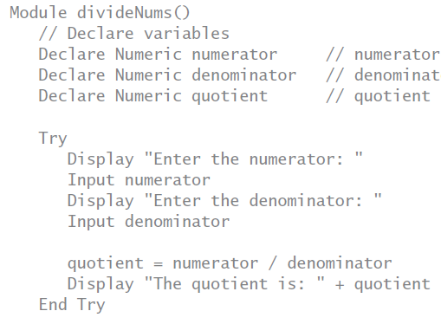
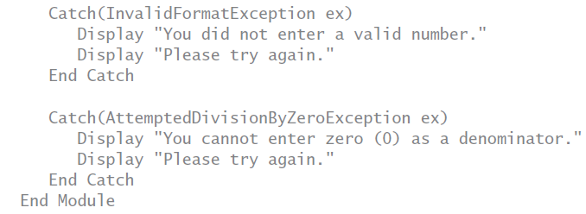

Slide 28
Types of Data Validation (cont’d.)
Exception types
  Predefined
  Programmer-defined
Complete Program 9-2 on pages 350-351
  Then convert to JavaScript

Slide 29
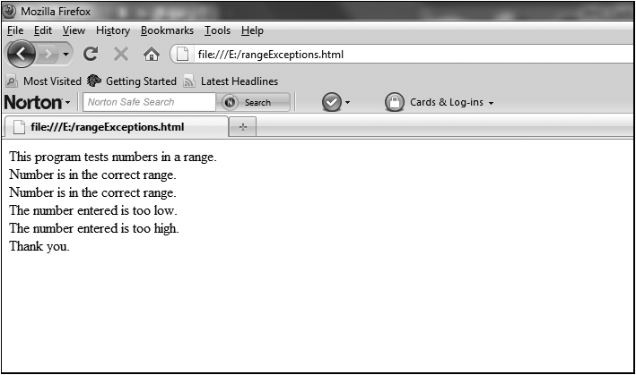
Types of Data Validation (cont’d.)
Figure 9-3 The rangeExceptions.html program in a Web browser

Slide 30
Using Multilevel Menus
Menus can have submenus
  Known as multilevel menus
Menu design
  Use modules as a starting point
Example: small business data processing
  Customer service and order processing
  Each choice has its own submenu
  Another choice to exit the application
  Menu choices displayed in main module

Slide 31
Using Multilevel Menus (cont’d.)
Complete Program 9-3 on pages 353-355
  Then convert to JavaScript
  Recall JavaScript syntax rules:
    Modules (functions) placed in <head> section
    Conditions enclosed in parentheses
    Keywords are lowercase
    Convert user input to uppercase
    A do-while loop ends with closing brace, the keyword while, the condition, and a semicolon

Slide 32
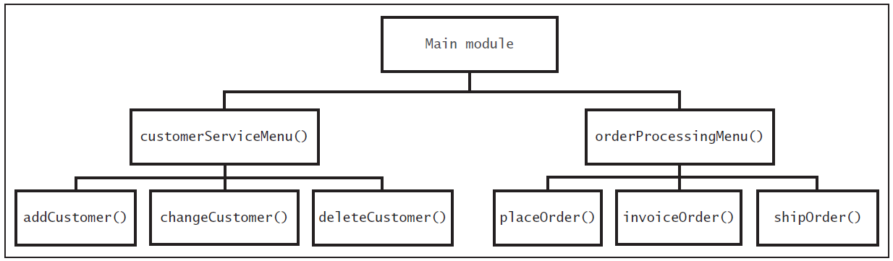
Using Multilevel Menus (cont’d.)
Hierarchy chart
  Graphical tool
  Illustrates relationship between modules
Figure 9-4 A hierarchy chart for the Company Menu program

Slide 33
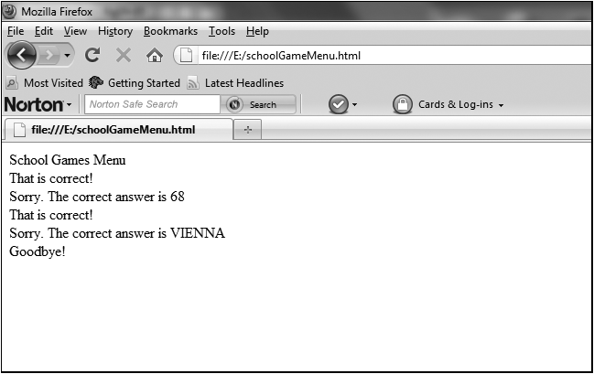
Using Multilevel Menus (cont’d.)
Complete Programmer’s Workshop on pages 357-363
  Then convert to JavaScript
Figure 9-6 The schoolGameMenu.html program in a Web browser

Slide 34
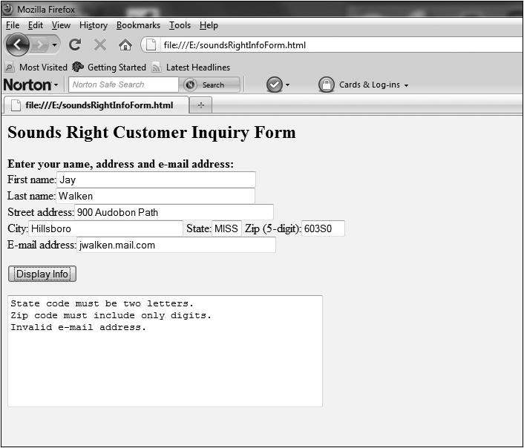
Using Multilevel Menus (cont’d.)
Complete Object Lesson on pages 364-368
Figure 9-8 The soundsRightInfoForm.html program in a Web browser

Slide 35
Summary
Interactive processing
  Requires data input validation
  Users must correct invalid data immediately
Menus limit users’ input to valid choices
Single-level menus go directly to selection
Multilevel menus have one or more submenus
Using modules for menu choices
  Works well with top-down design

Slide 36
Summary (cont’d.)
Stub: module without all code developed
Menus often represented as While loops
  Repeat until user enters value to exit menu
Validation loop repeats until valid data entered
Types of data validation
  Data type, presence, range, and logical relationships
Exception handling: method of catching errors
  Consists of Try and Catch blocks

